Slide 1
Introduction to Servlet

Slide 2
Objective
To learn
  Motivation
  Installation of Apache Tomcat Server
  Development & Deployment of Web application
Jackson, Web Technologies: A Computer Science Perspective, © 2007 Prentice-Hall, Inc. All rights reserved. 0-13-185603-0

Slide 3
Outcome
Students will be able to
  Install Apache Tomcat server
  Development & Deployment of web application
Jackson, Web Technologies: A Computer Science Perspective, © 2007 Prentice-Hall, Inc. All rights reserved. 0-13-185603-0

Slide 4
Servlet vs Spring Boot Analogy
Servlet = Driving a manual car
  You control everything manually.
  You start the engine, change gears, control clutch, acceleration, etc.
  Similarly, in Servlets, the developer handles:
    Request processing
    Response generation
    Session management
    URL mapping
    Configuration in web.xml
Spring Boot = Driving an automatic car
  Most things are automated.
  You only focus on driving, not on gear control.
  Similarly, Spring Boot automatically handles:
    Server configuration
    Dependency management
    Request mapping using annotations (@RestController, @GetMapping)
    Embedded servers like Tomcat

Slide 5
Why Servlet?
Even though modern frameworks like Spring Boot or Node.js often hide low-level details, understanding Servlets is still very important.
  Servlets are the core building blocks of Java web applications.
  All higher-level frameworks like Spring MVC or JSF internally use Servlets.
  Knowing Servlets helps you understand what happens under the hood — like how requests and responses flow.
Jackson, Web Technologies: A Computer Science Perspective, © 2007 Prentice-Hall, Inc. All rights reserved. 0-13-185603-0

Slide 6
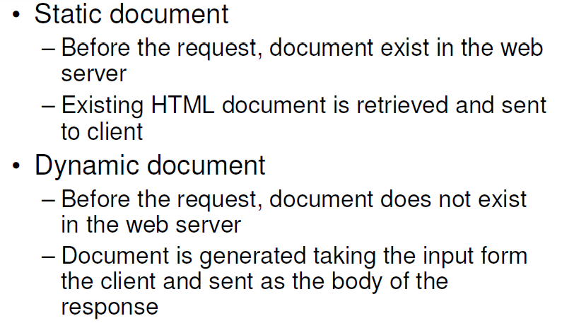
Server-side Programming
Jackson, Web Technologies: A Computer Science Perspective, © 2007 Prentice-Hall, Inc. All rights reserved. 0-13-185603-0

Slide 7
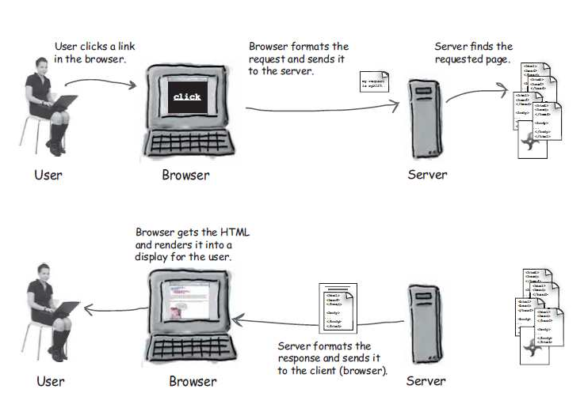
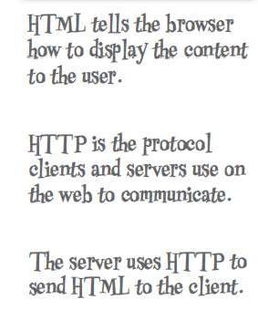
Static and Dynamic Document
Jackson, Web Technologies: A Computer Science Perspective, © 2007 Prentice-Hall, Inc. All rights reserved. 0-13-185603-0

Slide 8
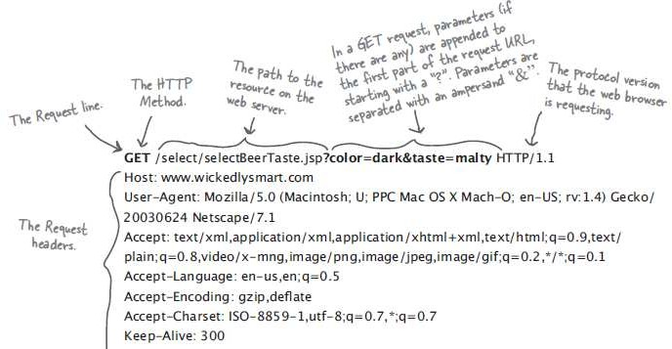
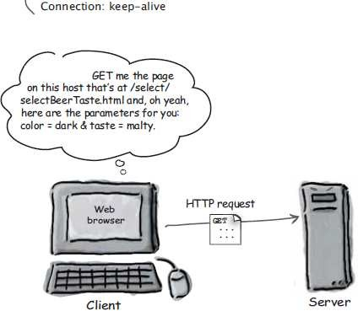
HTTP Request
K. Vallidevi
5

Slide 9
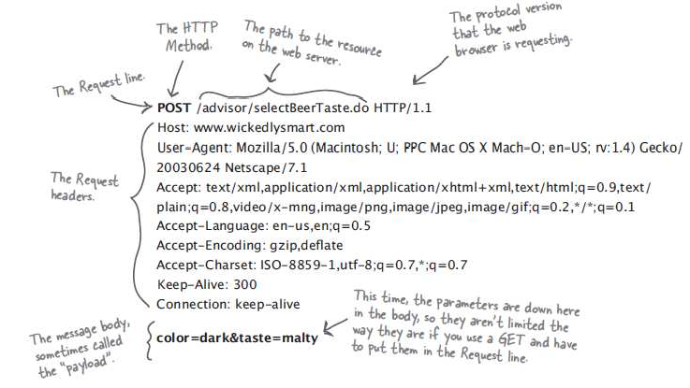
HTTP Request
K. Vallidevi

Slide 10
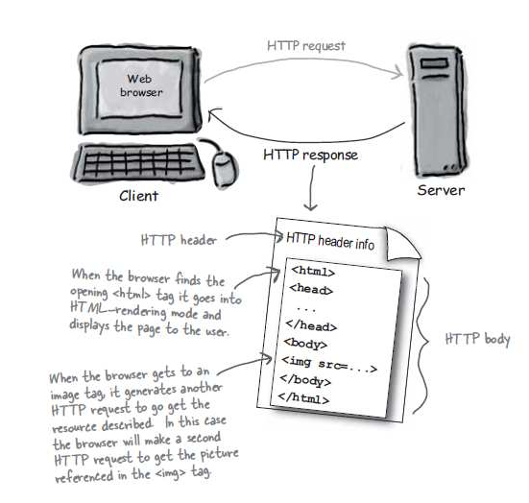
HTTP Response has HTML in it
K. Vallidevi

Slide 11
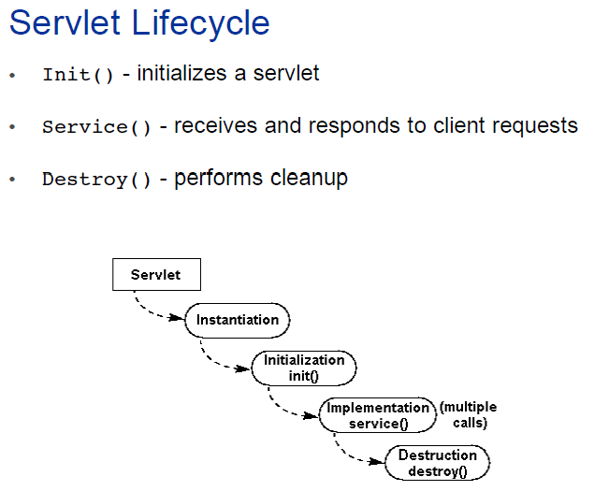
Servlet Lifecycle Flow
Servlet Loaded → init() → service() → doGet()/doPost() → destroy()
K. Vallidevi

Slide 12
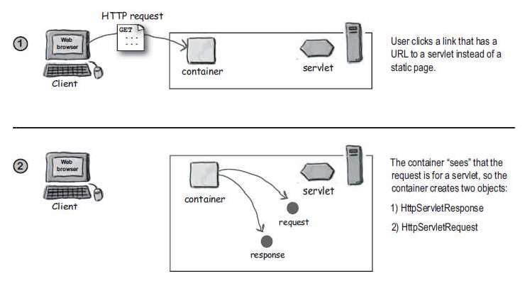
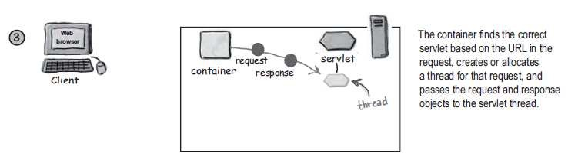
K. Vallidevi

Slide 13
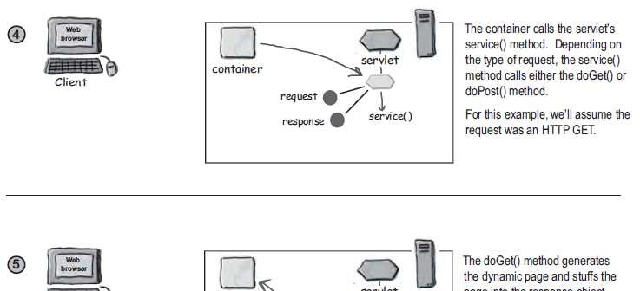
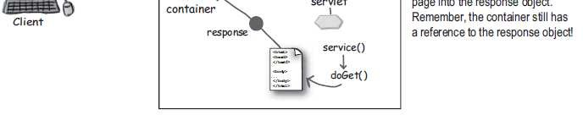
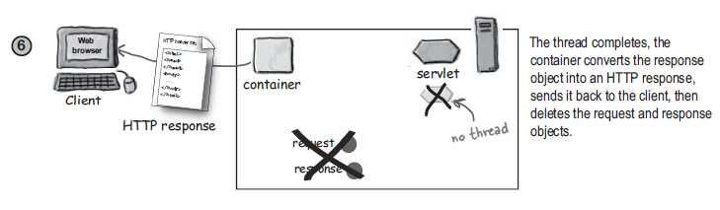
K. Vallidevi

Slide 14
Complete Lifecycle Flow
Client (Browser)
↓
HTTP Request
↓
Servlet Container (Tomcat)
↓
URL Mapping
↓
Load Servlet (if first time)
↓
init()
↓
service()
↓
doGet() / doPost()
↓
Business Logic
↓
Generate Response
↓
HTTP Response to Browser
init() → called once
service() → called for every request
doGet()/doPost() → handles specific HTTP methods
destroy() → called when servlet is removed

Slide 15
Installation of Tomcat Server
In Google, Type Apache Tomcat Installation Ubuntu 16.04 and find the liquid website
Download tar file of Apache Tomcat 8.5.50 from Liquidweb site
Extract and place it in /usr/local
Check the version of java and its availability
Usually we find in /usr/lib/jvm
Need to set JAVA_HOME, PATH & CATALINA_HOME in bashrc file
Jackson, Web Technologies: A Computer Science Perspective, © 2007 Prentice-Hall, Inc. All rights reserved. 0-13-185603-0

Slide 16
Installation of Tomcat Server
bashrc is a hidden file in home folder (~)
Open the bashrc file using nano editor
sudo nano ~/.bashrc
Add the following
  JAVA_HOME=“/usr/lib/jvm/java-1.8-openjdk-amd64”
  PATH=$PATH:$JAVA_HOME
  CATALINA_HOME=“/usr/local/apache-tomcat=8.5.50
Update bashrc file using any one of the commands
  source ~/.bashrc
  . ~/.bashrc
Jackson, Web Technologies: A Computer Science Perspective, © 2007 Prentice-Hall, Inc. All rights reserved. 0-13-185603-0

Slide 17
Installation of Tomcat Server
Check the environment variables by the following commands
  $JAVA_HOME
  $PATH
  $CATALINA_HOME
Start the server
  $CATALINA_HOME/startup.sh
Type the following in browser to check the administration page of Tomcat
  http://localhost:8080
Jackson, Web Technologies: A Computer Science Perspective, © 2007 Prentice-Hall, Inc. All rights reserved. 0-13-185603-0

Slide 18
Installation of Tomcat Server
Take demo Servlet from the following link
  https://www.javatpoint.com/steps-to-create-a-servlet-using-tomcat-server
Extract the folder, you will get demo servlet
Place the demo servlet in webapps folder in apache-tomcat-8.5.50
Type the following in browser to check demo servlet
  http://localhost:8080/demo
Shutdown the server
  $CATALINA_HOME/bin/shutdown.sh
Jackson, Web Technologies: A Computer Science Perspective, © 2007 Prentice-Hall, Inc. All rights reserved. 0-13-185603-0

Slide 19
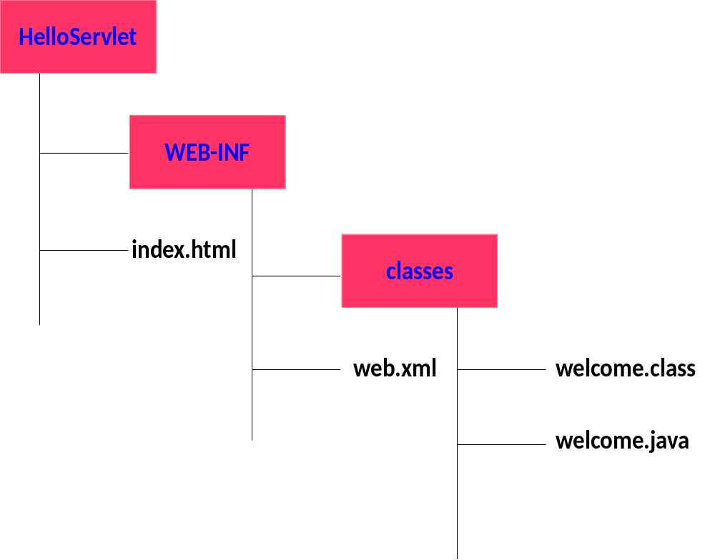
Development of our FirstServlet
Create the following hierarchy
Jackson, Web Technologies: A Computer Science Perspective, © 2007 Prentice-Hall, Inc. All rights reserved. 0-13-185603-0

Slide 20
Development of our FirstServlet
Index.html
<html>
<body>
<form method=“get” action=“hello”>
<input type=“submit”>
</form>
</body>
</html>
Jackson, Web Technologies: A Computer Science Perspective, © 2007 Prentice-Hall, Inc. All rights reserved. 0-13-185603-0

Slide 21
Development of our FirstServlet
Web.xml
<web-app>
<servlet>
<servlet-name>MyServlet1</servlet-name>
<servlet-class>First</servlet-class>
</servlet>
<servlet-mapping>
<servlet-name>MyServlet1</servlet-name>
<url-pattern>/hello</url-pattern>
</servlet-mapping>
</web-app>
Jackson, Web Technologies: A Computer Science Perspective, © 2007 Prentice-Hall, Inc. All rights reserved. 0-13-185603-0

Slide 22
Development of our FirstServlet
First.java
import javax.servlet.http.*;
import javax.servlet.*;
import java.io.*;
public class First extends HttpServlet{
public void doGet(HttpServletRequest req,HttpServletResponse res)throws ServletException,IOException
{
res.setContentType("text/html");
Jackson, Web Technologies: A Computer Science Perspective, © 2007 Prentice-Hall, Inc. All rights reserved. 0-13-185603-0

Slide 23
Development of our FirstServlet
First.java
PrintWriter pw=res.getWriter();
pw.println(“<html>”);
pw.println(“<body>”);
pw.println(“<p>Hello World</p>”);
pw.println(“</body>”);
pw.println(“</html>”);
pw.close();
}}
Jackson, Web Technologies: A Computer Science Perspective, © 2007 Prentice-Hall, Inc. All rights reserved. 0-13-185603-0

Slide 24
Development of our FirstServlet
Deployment of application
Place the folder FirstServlet in webapps folder
Copy the servlet-api.jar available in tomcat/lib folder to /usr/lib/jvm/java…/jre/lib/ext folder
Compile the First.java to get its class file
Start the server
Execute the servlet
http://localhost:8080/HelloServlet
Shutdown the server
Jackson, Web Technologies: A Computer Science Perspective, © 2007 Prentice-Hall, Inc. All rights reserved. 0-13-185603-0

Slide 25
Development of our FirstServlet
In case of myfirst.html instead of index.html
In deployment descriptor, add the following
<welcome-file-list>
<welcome-file>myfirst.html</welcome-file>
</welcome-file-list>
Try executing the web application
Jackson, Web Technologies: A Computer Science Perspective, © 2007 Prentice-Hall, Inc. All rights reserved. 0-13-185603-0

Slide 26
Development of our FirstServlet
Add style in First.java and to retrieve the value from form
In index.html
  <input type=“text” name=“t1”>
In First.java
  String str=resp.getParameter(“t1”);
  out.println(“<p>”+str+”</p>”);
Jackson, Web Technologies: A Computer Science Perspective, © 2007 Prentice-Hall, Inc. All rights reserved. 0-13-185603-0

Slide 27
Simple Questions
What environment variables have to be set during installation of Apache Tomcat Server?
How to set or update these environment variables in Ubuntu?
How to configure web application?
What is deployment descriptor?
How to retrieve data in servlet from the form?
Jackson, Web Technologies: A Computer Science Perspective, © 2007 Prentice-Hall, Inc. All rights reserved. 0-13-185603-0

Slide 28
References
Deitel and Deitel and Nieto, ―Internet and World Wide Web - How to Program‖, Prentice Hall, 5th Edition, 2011.
Jeffrey C and Jackson, ―Web Technologies A Computer Science Perspective‖, Pearson Education, 2011.
Jackson, Web Technologies: A Computer Science Perspective, © 2007 Prentice-Hall, Inc. All rights reserved. 0-13-185603-0

Slide 29
Summary
Students will be able to
  Install Apache Tomcat server
  Development & Deployment of web application
Jackson, Web Technologies: A Computer Science Perspective, © 2007 Prentice-Hall, Inc. All rights reserved. 0-13-185603-0

